Slide 1
Mindset

Slide 2
Today’s Learning Target and Success Criteria
I can deepen my understanding of Mindset.
To meet this Learning Target I need to be able to:
Determine my mindset
Identify characteristics of a fixed mindset
Identify characteristics of a growth mindset
Explain the importance of developing a growth mindset in myself

Slide 3
What Are You? Take the Mindset Quiz
Complete the Mindset Quiz – individually and honestly - this is for you!
Using the Answer Key, determine the mindset for each question on the quiz
Determine your score

Slide 4
Answer Key
Ability mindset – fixed
Ability mindset – growth
Ability mindset – growth
Personality/character mindset – fixed
Personality/character mindset – growth
Ability mindset – growth
Ability mindset – fixed
Ability mindset – fixed
Ability mindset – growth
Personality/character mindset - growth
Ability mindset – fixed
Personality/character mindset – fixed
Ability mindset – growth
Ability mindset – fixed
Ability mindset – growth
Ability mindset – fixed
Personality/character mindset – fixed
Personality/character mindset – growth
Ability mindset – growth
Ability mindset - fixed

Slide 5
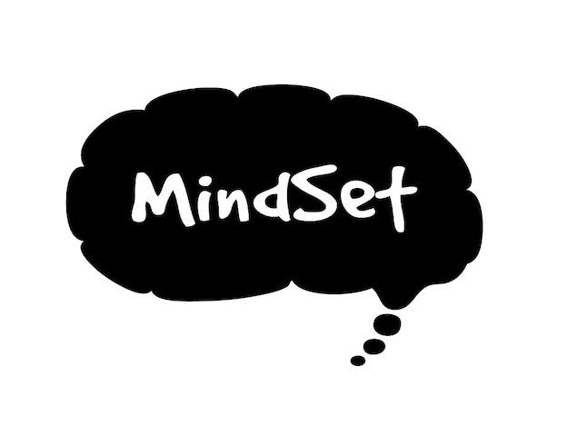
Scoring:
Growth Questions
Strongly agree – 3 points
Agree – 2 points
Disagree – 1 point
Strongly disagree – 0 points
Fixed Questions
Strongly agree – 0 points
Agree – 1 point
Disagree – 2 points
Strongly disagree – 3 points
Add up points.
Strong Growth Mindset 60-45 points
Growth Mindset with some Fixed ideas
44-34 points
Fixed Mindset with some Growth ideas
33-21 points
Strong Fixed Mindset
20-0 points

Slide 6
Think on Your Own…
How do YOU define Intelligence?

Slide 7
Is it the ability to use reason and logic?
Is it the ability to write and speak clearly?
Is it limited to one’s performance in school?
Is it behavior in social situations?
How about knowing when you’re wrong?
Not that simple, right?

Slide 8
What is Intelligence Anyway?
Intelligence: power of learning, understanding and reasoning; mental ability
--Even students with average intelligence can be top students if they study hard

Slide 9
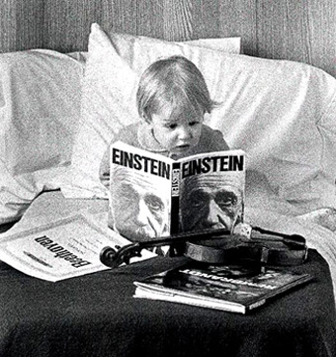
Born Smart?

Slide 10
Importance of Development
At birth, we can’t WALK or TALK
These abilities don’t pop up overnight….
….. they DEVELOP as we LEARN!!
I’m an engaged learner!

Slide 11
You Can Grow Your Intelligence
Notes:
Research shows that the brain is more like a muscle-it changes and gets stronger when you use it
Scientists have been able to show just how the brain grows and gets stronger when you learn
Muscles become larger and stronger with exercise, when you stop exercising the muscles shrink and get weaker
“Use it or lose it!”

Slide 12
Which Traits Are Children Born With?
The Drive to Help (Altruism)
The Drive to Master
Problem-Solving
Social Connection
Instinctive Optimism
Intrinsic Motivation
The Drive to Acquire Knowledge & Develop Intelligence

Slide 13
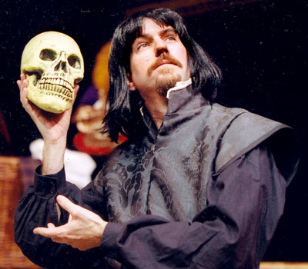
So, are we born…
Good at math?
Good at acting?
Good at science?
Good at music?

Slide 14
Labels…

Slide 15
Feeling This Creates in Children:

Slide 16
How Do We Remain Engaged Learners?
MINDSET MATTERS!

Slide 17
Prime Minister
Winston Churchill REPEATED a grade during elementary school
He was placed in the LOWEST division of the LOWEST class

Slide 18
Composer
Beethoven’s teacher called him a HOPELESS composer
He wrote 5 of his greatest SYMPHONIES while DEAF

Slide 19
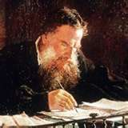
Writer
Leo Tolstoy dropped out of college
He was described as both “UNABLE and unwilling to LEARN"

Slide 20
Role Models
….Einstein's teacher said that he was ‘academically subnormal’
….Michael Jordan's coach said that he wasn’t more talented than other people…
…..Walt Disney was told that he lacked ‘creative imagination’

Slide 21
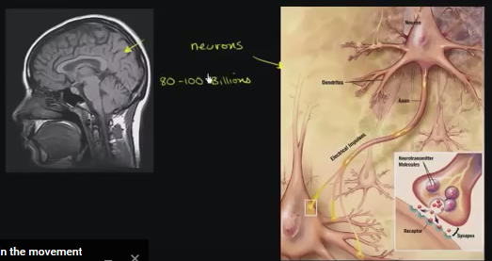
“Growing Your Mind” by Khan Academy
https://www.youtube.com/watch?v=WtKJrB5rOKs
Notes:
https://www.youtube.com/watch?v=WtKJrB5rOKs
How do people become more intelligent?
How does the diagram of the neurons “At birth vs. at age 6” demonstrate this?
What about the second diagram of the nerves of the animal living in a cage vs an animal living with other animals and toys?
How are brains like muscles?
When do our brains grow the most?

Slide 22
Neuroplasticity by Sentis
https://www.youtube.com/watch?v=ELpfYCZa87g
Notes:
https://www.youtube.com/watch?v=ELpfYCZa87g
What is neuroplasticity?
How does neuroplasticity work?
How can you “rewire” your brain?

Slide 24
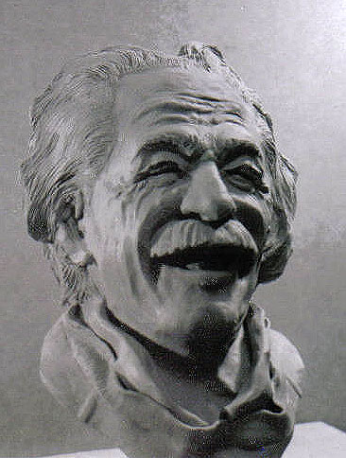
Fixed mindset
Intelligence is CARVED IN STONE
Scores on a test
MEASURE POTENTIAL
Intelligent people shouldn’t have to WORK HARD
Failure reflects a LACK of INTELLIGENCE

Slide 25
Fixed Mindset: 40% of Kids

Slide 26
Man on Fire – So What Do I Do?
https://www.youtube.com/watch?v=OWU2ygZr18c&list=PL26TWf6nClm2IIdN9OtI9Ls4PI0ZZX_zK&index=19

Slide 27
Growth mindset
Intelligence is MALLEABLE
Learning requires HARD WORK and EFFORT
ALL individuals CAN LEARN and improve
We CANNOT MEASURE a person’s POTENTIAL

Slide 28
Growth Mindset: 40% of Kids

Slide 29
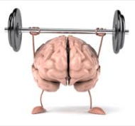
Mindsets Can Change!
Rigorous research also shows that mindsets can change
When they are changed to have a Growth Mindset, students do better

Slide 30
Man on Fire – The Gunshot Holds no Fear and Training
https://www.youtube.com/watch?v=4WYlRcuLpR4

Slide 31
Three Mindset Rules

Slide 32
Mindset Rule #1
Fixed Mindset
Growth Mindset
Look smart at all costs
Learn at all costs

Slide 33
Mindset Rule #2
Fixed Mindset
Growth Mindset
It should come naturally
Work hard – effort is key

Slide 34
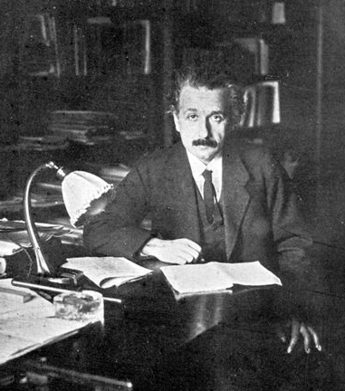
Do Geniuses Work-- Or Does it Just Come Naturally?

Slide 35
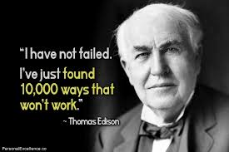

Slide 36
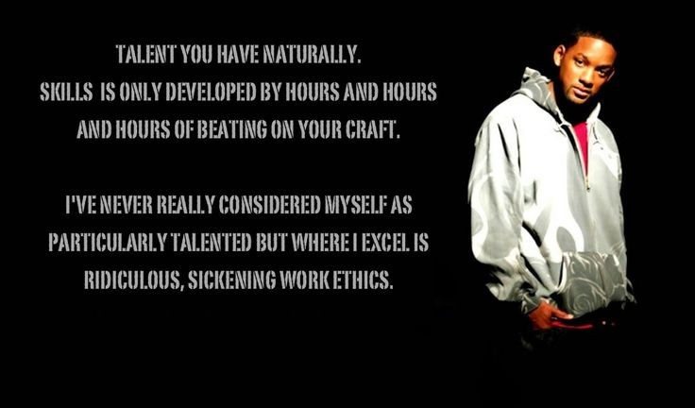

Slide 37
Mindset Rule #3
Fixed Mindset
Growth Mindset
It’s all about me…
Hide mistakes
Avoid showing deficiencies
It’s all about learning…
Capitalize on mistakes
Confront deficiencies

Slide 38
After a setback…
Fixed Mindset
Growth Mindset
“I’m spending less time on this subject from now on.”
“I would try not to take this subject ever again.”
“Maybe I should cheat on the next test…”
“I need to work harder in this class from now on.”
“I should spend more time studying for the tests.”

Slide 39
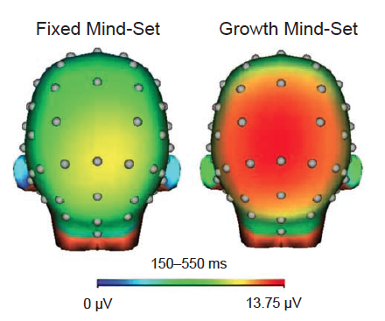
Growth Mindset Brains Work Harder!
Moser et al., 2011

Slide 40
People have increased their IQ by 30 POINTS
With the right mindset people can achieve more than an IQ test might reveal

Slide 41
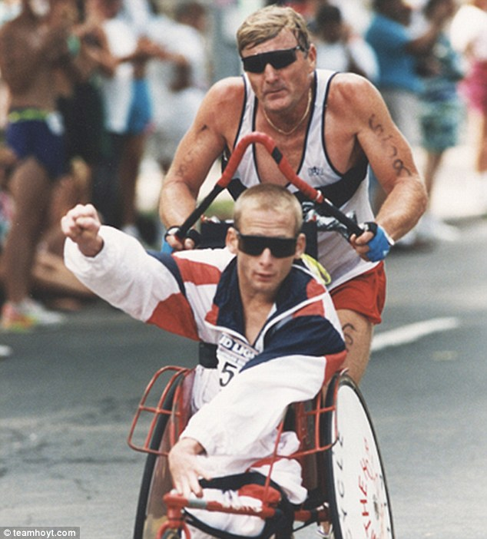
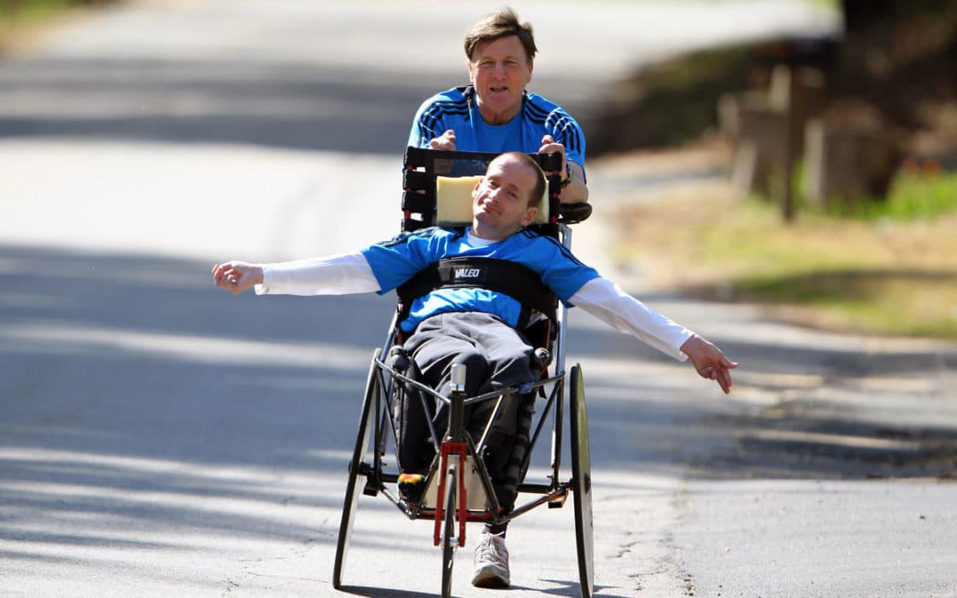
Team Hoyt
“Yes You Can!”

Slide 42
Yes We Can!
Article: http://www.teamhoyt.com/About-Team-Hoyt.html
Video (Jimmy V Perseverance Award): https://www.youtube.com/watch?v=xBXy1EH4nYc&index=2&list=PLko-Gs2a2nXhGnvdSOQW22A7r5pIkOEYF
Better Quality:
https://www.youtube.com/watch?v=-FQpAtmzGDM&list=PLko-Gs2a2nXhGnvdSOQW22A7r5pIkOEYF&index=3
Video (I Can Only Imagine – Team Hoyt): https://www.youtube.com/watch?v=MnhDyc7AZ5U

Slide 43
Writing Assignment: Discuss a time when you overcame a struggle in learning and learned to solve a problem. (Type this up in google docs)
In this story highlight:
Hard work
Strategies
Help from others

Slide 44
When I was in middle school, I remember struggling with adding negative numbers. I had
a hard time figuring out what a ‘negative’ even meant when talking about a number - how
can you have less than nothing? I ended up going through many practice problems and
continuing to get many of them wrong. I was a very shy kid, so I didn’t ask my teacher many
questions. My thought was that I had reached ‘the peak’ of my math talent, and it was all
downhill from here. I eventually asked my mom about this topic and she explained to me
the basic concept of negative numbers. This helped me understand it a little, but it was still
fuzzy to me. I then researched online for some real-life contexts to show what these
mysterious numbers represented outside of some abstract universe. Some of them made
sense, and others didn’t. I still didn’t entirely get it and I was so frustrated that I wanted to
just give up (or continue hoping that negative numbers were not going to appear in math
class ever again). I started to dislike math simply because I couldn’t understand it anymore.
Instead of entirely giving up on my academic career, I eventually mustered up the courage
to ask my teacher for help as well. She explained it in a few different ways, and gave me
new strategies to try out. After some practice with these new strategies, I started to solidify
my understanding of negatives which allowed me to quickly pick up basic algebra
afterwards. While it was a lot of work and I wanted to give up at many points during my
journey, I eventually was able to ‘rewire’ my brain so that negative numbers actually made
sense to me.

Slide 45
Motivational Framework Supporting Mindsets
Goals
Effort
Responses
Strategies

Slide 46
Goals: Things We Aim For

Slide 47
Different Ways People View Failure
Some people view it as a
learning opportunity. They value learning.
While others view it as
confirmation that they are not smart.
Notes:
47

Slide 48
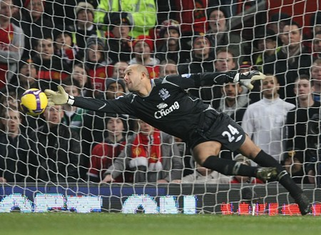
Why do people have different views of failure? Because they have different goals….
Some people create learning goals.
Others create performance goals.
Notes:
48

Slide 49
Fixed Mindset
Growth Mindset
Performance-based goals
Potential can be measured – seeking validation from others
Low mark = Not smart
Anxiety results from success or failure
Learning-based goals
The goal is mastery and competence
Scores show how you are doing now, not your future potential
Learning goals increase performance and enjoyment and decrease negative emotions

Slide 50
Consequences of Beliefs
 | Fixed Mindset | Growth Mindset
Goal in School?
Values effort?
Reaction to Failure?

Slide 51
Consequences of Beliefs
 | Fixed Mindset | Growth Mindset
Goal in School? | Look Smart
Values effort?
Reaction to Failure?

Slide 52
Consequences of Beliefs
 | Fixed Mindset | Growth Mindset
Goal in School? | Look Smart | Learn
Values effort?
Reaction to Failure?

Slide 53
Goals
Looking smart is most important:
“The main thing I want when I do my school work is to show how good I am at it."
Learning is most important:
“It’s much more important for me to learn things in my classes than it is to get the best grades.”
 | Fixed mindset | Growth mindset
Goals? | Look Smart | Learn
Values effort?
Reaction to Failure?
Notes:
53

Slide 54
Effort: Is it required for success?
Notes:
54

Slide 55
Effort
Those with a growth mindset see effort as a necessary part of success.
They try harder when faced with a setback.
Effort = success.
They use effort to overcome difficulty.
Those with a fixed mindset view effort as a reflection of low intelligence.
Hard work means ‘I don’t get it’, ‘I’m not intelligent’
Effort = lack of ability

Slide 56
Effort
People were asked about intelligence and how much they thought it was due to effort and how much they thought it was due to ability
Intelligence=______% effort _______% ability
Fixed = 35% effort vs. 65% ability
Growth = 65% effort vs. 35% ability

Slide 57
Consequences of Beliefs
 | Fixed Mindset | Growth Mindset
Goal in School? | Look Smart | Learn
Values effort? | No
Reaction to Failure?
Notes:
57

Slide 58
Consequences of Beliefs
 | Fixed Mindset | Growth Mindset
Goal in School? | Look Smart | Learn
Values effort? | No | Yes
Reaction to Failure?

Slide 59
Value of Effort
Effort is negative:
“To tell the truth, when I work hard at my school work it makes me feel like I’m not very smart."
Effort is positive:
“The harder you work at something, the better you’ll be at it.”
 | Fixed mindset | Growth mindset
Goals? | Look Smart | Learn
Values effort? | No | Yes
Reaction to Failure?

Slide 60
The Self-Esteem Movement

Slide 61
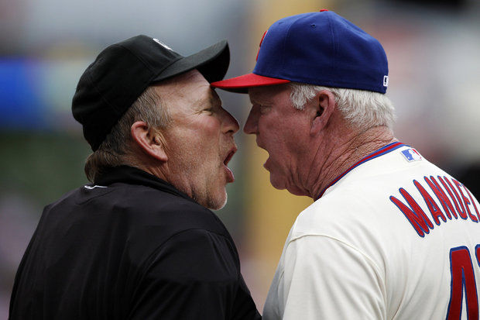
Responses: How we React to Events

Slide 62
When faced with failure or challenge, people with a FIXED mindset
Under-represent past success and over-represent failures (pessimism)
Explain the cause of events as something from within themselves (stability)
Focus on feeling rather than learning
Become depressed, de-energized and lose self-esteem
Denigrate their intelligence (I’m stupid…)

Slide 63
Growth mindset response to setbacks and failures…
Resilient
Focus on learning rather than feelings
Consider new ways to do something
Use self-motivating statements (I can…)
Notes:
63

Slide 64
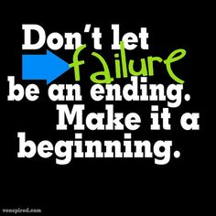

Slide 65
Response: Mastery
Pay attention to learning information, so you can do better on future tests.
Focus on what they you are learning, rather than focusing on how you feel.
Try out new ways of doing things.
Use self-motivating statements such as ‘ the harder it gets the harder I try’.

Slide 66
Consequences of Beliefs
 | Fixed Mindset | Growth Mindset
Goal in School? | Look Smart | Learn
Values effort? | No | Yes
Reaction to Failure? | Give Up

Slide 67
Consequences of Beliefs
 | Fixed Mindset | Growth Mindset
Goal in School? | Look Smart | Learn
Values effort? | No | Yes
Reaction to Failure? | Give Up | Work Harder

Slide 68
Response to Failure
Helpless
“I would spend less time on this subject from now on.”
“I would try not to take this subject ever again.”
“I would try to cheat on the next test.”
Resilient
“I would work harder in this class from now on.”
“I would spend more time studying for the tests.”
 | Fixed mindset | Growth mindset
Goals? | Look Smart | Learn
Values effort? | No | Yes
Reaction to Failure? | Give up | Work Harder

Slide 69
Consequences of Mindsets
 | Fixed Mindset | Growth Mindset
Goal in School? | Look Smart | Learn
Values effort? | No | Yes
Reaction to Failure? | Give Up | Work Harder
Achievement | Lower | Higher

Slide 70
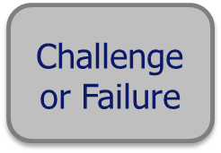
Recursive Processes
Higher Achievement
Increased Effort
Growth Mindset
Fixed
Mindset
Reduced Effort
Lower Achievement
Notes:
70

Slide 71
Final proof? Babies aren’t stupid! They grow connections.
The brain must develop billions of connections:
every green dot is a junction between one nerve and another

Slide 72
Growth Mindset and Achievement
Decades of research show a powerful relationship between
mindset and achievement.
Students’ beliefs about intelligence and learning impact:
Motivation
Academic behaviors (e.g., studying and seeking help)
Responses to challenges and setbacks
Academic achievement
Notes:
72

Slide 73
Mindset Tips for Students
Create Learning Targets (goals)
Make plans
Imagine the brain making new connection each time you learn something
Concentrate on believing that you can
When you meet challenges, setbacks, or adversity ask yourself ‘what can I learn from this?’
Tell other people about your growth mindset
What else have you come up with…?

Slide 74
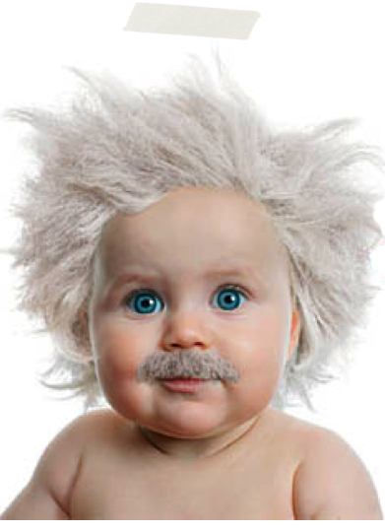
Born smart?
Mindset has a significant impact on motivation and performance,
Beliefs can be changed

Slide 75
Activity:
Make Posters (I will hang the top 4 on my wall. We will vote)

Slide 76
Movie:

